Slide 1
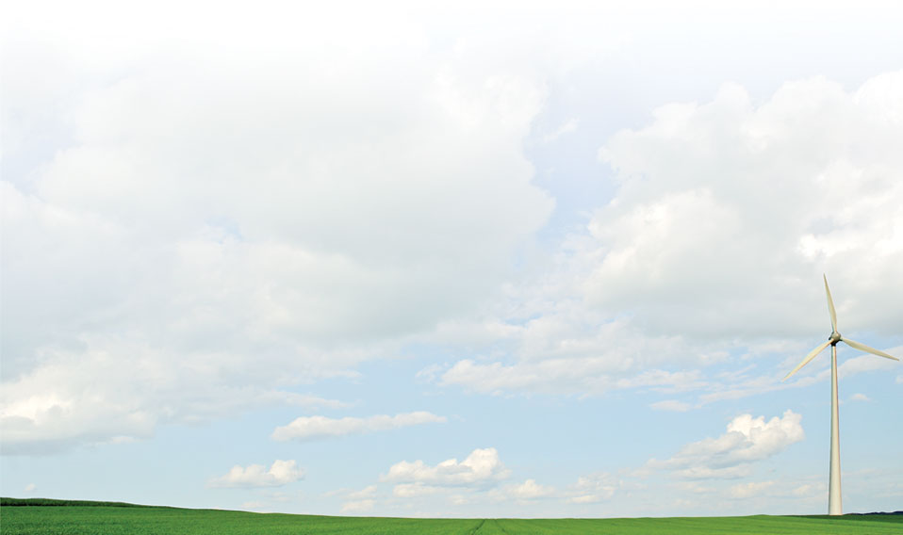
Collectors
This section will introduce you to objects that record data from groups of objects.

Slide 2
Output object
Implemented in tape module
One of two primary ways of collecting data
Collectors observe aggregates of properties of a group of objects
Several possible destinations for data
  File : source is a specially formatted files
  ODBC : source is a database
  Memory : source is a global variable

Slide 3
Group
Similar to shaper group
Search is done first time only
Search result is reused thereafter
Groups must be constant over time
Search criteria use all properties of objects
  Header property: class, parent, rank, latitude, longitude, in_svc, out_svc, name
  Object properties sometimes work
Example: group "class=house";

Slide 4
Property
Same as recorder, but with aggregators
  count, min, max, avg, std, sum, prod
  mean, var, kur
  gamma
Parts used for complex values
  real, imag
  mag, ang, arg
Example: property "sum(power.mag)"

Slide 5
File
Meaning differs based on filetype property
Format can be system specific
  “/” are normally used; “\” allowed in Windows
File must be writeable
Path to file is not automatically created
Existing file are overwritten
Write failure is warned, but ignored

Slide 6
Interval
Determine the sampling interval for data
Units are seconds
-1 means sample transients
0 means sample each iteration

Slide 7
Limit
The maximum number of samples
Limits the size of the output file
0 is default
0 means no limit

Slide 8
Trigger
Specifies condition to start recording
Works only for target property
Usual compare ops apply
Examples
  “< 0” : starts recording when property is negative
Once triggered, recording continues to limit

Slide 9
Example
object collector {
group “class=house”;
property “sum(power.mag)”;
}

Slide 10
Demo
Demo of play_rec_shp_coll.glm
    object house:0 {
    cooling_setpoint 90 degF;
    object lights:1{
    };
    object lights:2{
    };
    }
    object shaper{
    group id=1;
    property demand;
    file exercise_2_4_theat.shape;
    }
    object collector {
    file theat_collector.csv;
    group class=lights;
    property sum(energy_meter.real),avg(energy_meter.real); //no space...needs real since it is set up
    //complex
    interval 3600;
    limit 768;
    }

Slide 11
Exercises
Collect total power consumption for a population of 100 water heaters for one month.
Collect the hourly average, stdev, minimum and maximum indoor air temperature a population of 100 default houses for a week.
Collect the minimum and maximum voltages of all nodes in the IEEE 37-bus test model as it converges.

